Slide 1
Pointer

Slide 2
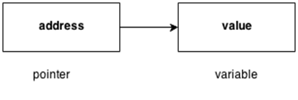
Pointers -
The pointer in C++ language is a variable, it is also known as locator or indicator that points to an address of a value.
Advantage of pointer -
1) Pointer reduces the code and improves the performance, it is used to retrieving strings, trees etc. and used with arrays, structures and functions.
2) We can return multiple values from function using pointer.
3) It makes you able to access any memory location in the computer's memory.

Slide 3
Usage of pointer -
There are many usage of pointers in C++ language.
Dynamic memory allocation - In c language, we can dynamically allocate memory using malloc() and calloc() functions where pointer is used.
2) Arrays, Functions and Structures - Pointers in c language are widely used in arrays, functions and structures. It reduces the code and improves the performance.
Symbols used in pointer -
Symbol | Name | Description
& (ampersand sign) | Address operator | Determine the address of a variable.
∗ (asterisk sign) | Indirection operator | Access the value of an address.

Slide 4
Declaring a Pointer
Pointer to int – int *a;
Pointer to char – char *c;
#include<iostream.h>
void main()
{
int number = 30;
int ∗p;
p = &number;
cout<<“Value of number: ”<<number;
cout<<“Value of p: ”<<p;
cout<<“Value of *p: ”<<*p;
}

